Slide 1
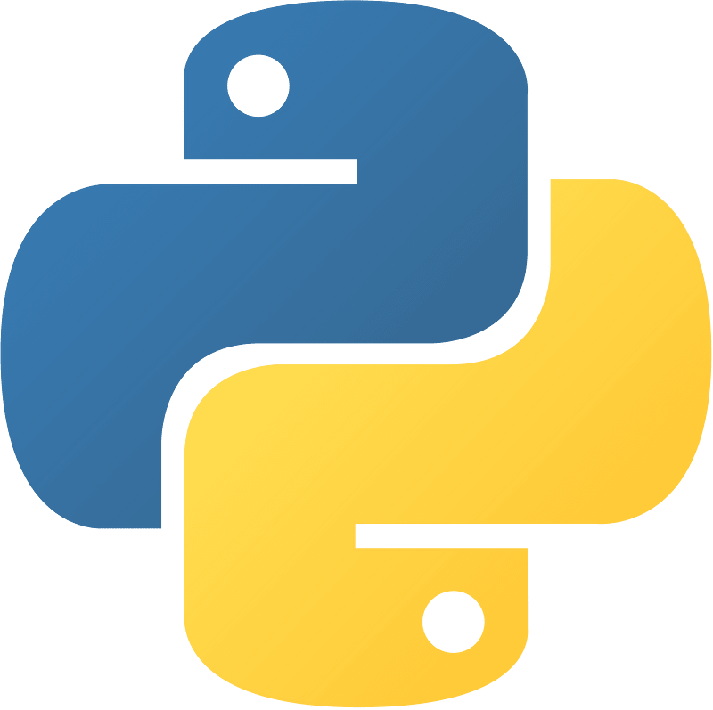
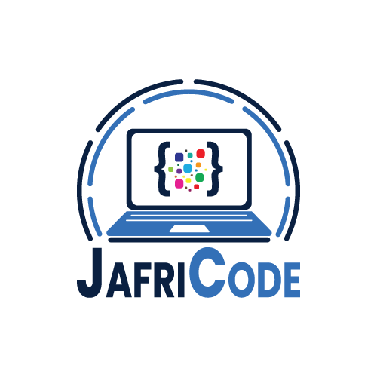
Advanced Python Programming
By: Faisal Zamir
Chapter 01 Introduction to Advanced Python
What is Advanced Python?
What you can learn in Advanced Python
Why learn Advanced Python?
Advanced Python

Slide 2
Advanced Python Programming
By: Faisal Zamir
Chapter 01 Introduction to Advanced Python
What is Advanced Python?
Advanced Python" typically refers to an elevated level of Python programming proficiency that encompasses complex concepts, advanced libraries, and mastery of language features beyond the basics
Advanced Python

Slide 3
Advanced Python Programming
By: Faisal Zamir
Chapter 01 Introduction to Advanced Python
What you can learn in Advanced Python?
Object-oriented programming: classes, inheritance, and polymorphism etc
Functional programming: lambda functions, map and filter functions, and recursion
Regular expressions: pattern matching and substitution
Decorators: modifying the behavior of functions and classes
Generators and iterators: creating and working with iterable objects
NumPy: numerical computing with arrays and matrices
Advanced Python

Slide 4
Advanced Python Programming
By: Faisal Zamir
Chapter 01 Introduction to Advanced Python
Pandas: data manipulation and analysis with data frames
Scikit-Learn: machine learning algorithms and tools
Django: web development framework for building complex web applications
Flask: lightweight web framework for building web applications and APIs
Multithreading and concurrency: executing multiple tasks simultaneously
Networking: communication between different machines and applications
Advanced algorithms and data structures: graph algorithms, trees, and heaps
Advanced Python

Slide 5
Advanced Python Programming
By: Faisal Zamir
Chapter 0 Introduction to Advanced Python
Why learn Advanced Python?
Enhanced career opportunities
Improved productivity
Increased flexibility
Better understanding of software engineering principles
Increased understanding of computer science concepts
Advanced Python

Slide 6
Advanced Python Programming
By: Faisal Zamir
Chapter 0 Introduction to Advanced Python
Why learn Advanced Python?
Enhanced career opportunities: Advanced Python skills are in high demand by employers in various industries, including data science, machine learning, web development, scientific computing, and more.
Improved productivity: Advanced Python features and libraries can help you automate tasks, manipulate data more effectively, and create more efficient and scalable programs.
Increased flexibility: With advanced Python skills, you'll have the ability to create more complex applications and programs, and solve a wider range of programming problems.
Better understanding of software engineering principles: Advanced Python topics such as object-oriented programming and design patterns can help you to develop better software engineering practices and write more maintainable and scalable code.
Increased understanding of computer science concepts: Advanced Python also covers concepts such as algorithms, data structures, and computer architecture, which can help you to gain a deeper understanding of computer science concepts.
Advanced Python

